Slide 1
Bearing Capacity of Duhok city depending on S.P.T results and laboratory tests Presented by Dr.Eng . Abdulkader Ahmad Hamy 16-04-2017

Slide 2
Abstract :
There are many types of soil in Duhok city , due to Geological conditions and physical- mechanical characteristics of these soil, such as Clayey silt, Silty clay, Limestone, Mixtures of Gravels with sand…etc.
The research aims to find Allowable Bearing Capacity for various types of soils in Duhok city , depending on one of the famous site investigation , called Standard Penetration Test ( S.P.T) , and laboratory tests .
The method of investigation carried out by executing many bore holes in the studied area , using special rotary drilling machine, for purpose of Geotechnical Engineering investigation

Slide 3
1- Introduction :
The most important part of the engineering constructions are foundations . It is well known that foundations transmit all loads of construction to the soil , from here is coming the importance of soil site in the building construction .
So, In order to achieve safety and economy of building constructions , the physical and mechanical characteristics of soil should be well known, to calculate allowable bearing capacity of soil .
There are many methods of Geotechnical Engineering investigation to determine Bearing Capacity of soil . Some of them depend on laboratory tests , such as shear tests , unconfined compression test , thriaxial tests , permeability test, compressibility test, sieve and hydrometer analysis, Aterberge Limits , specific gravity and volumetric data .
And other method depend on field tests such as Standard Penetration Test
( S.P.T ), Plate Load Test (P.L.T), Cone Penetration Test
( C.P.T ), Field Van Test ( F.V.T ), …..etc.

Slide 4
2- Geological condition of Duhok city :
Duhok city located in the north west of Kurdistan region , between two mountains , Bekher anticline in the north ,
and Zawa (Duhok ) anticline in the south .
According to geological condition , both mountains are composed of Pilaspi formation (limestone ) , and jercus formation presented by clayey silt .
Large parts of the soil in Duhok Basin are covered with clayey silt beds ,that vary in the color from brown to reddish , in addition to it is variable in thickness ,
and affected by erosion process of Bekher and Duhok mountains .

Slide 5
3-The process of study :
This study includes field investigation , sampling , laboratory tests , and calculation of allowable bearing capacity .
Boreholes was drilled by Special Rotary Drilling Machine , the depth ranges (15-25) m. The number and depth of borehole depend mainly on the height of building , nature of the soil , and engineering geological condition of the site .
During the drilling , S.P.T(Standard Penetration Test) was done , disturbed and undisturbed samples were taken to the laboratory .

Slide 6
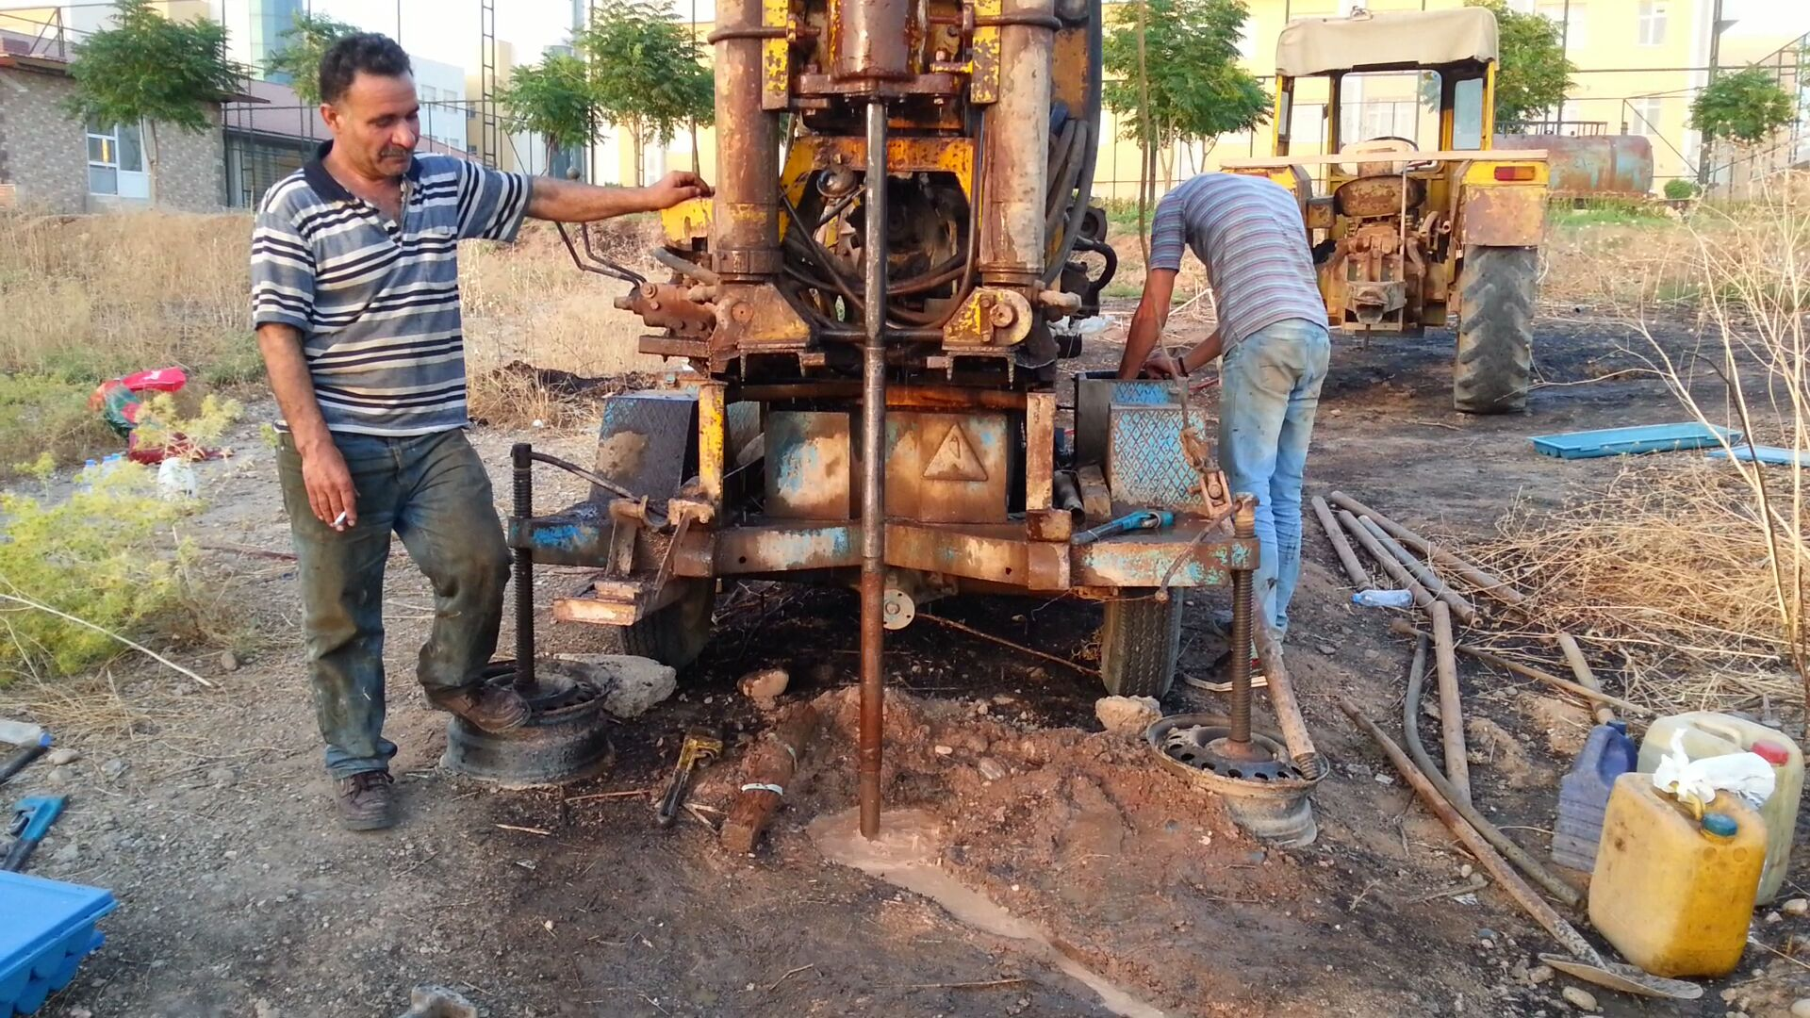

Slide 8
4- Studied area :
the following area were studied :
1- zere land site ( K.R.O ) .
2- Tanahee site : ( Newroz university site) .
3- shakhke site: ( Electric station site).
4- Shandokha site: ( French Village – Sheraton hotel site ) .
5- Azadi panorama ( women's hospital site ).
6- Malta site ( healthy center site ) , south of Roj city . 4-

Slide 9
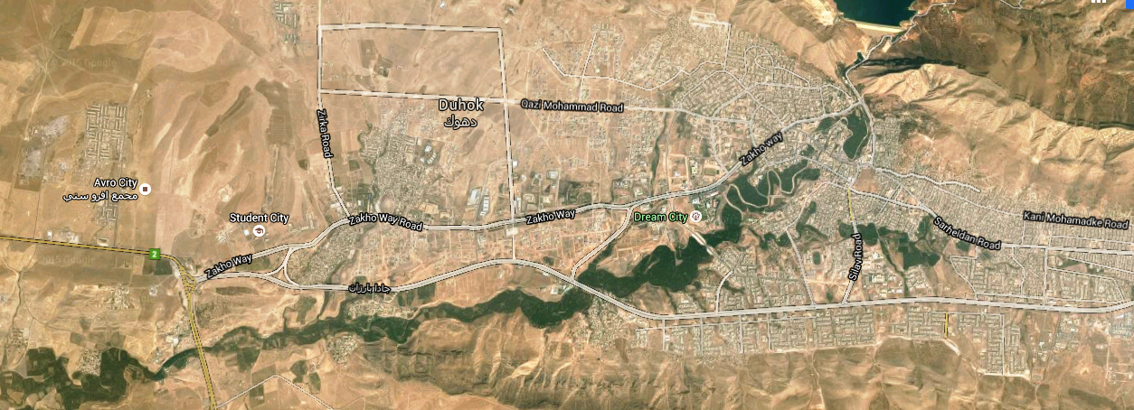
Map of Duhok city with location of studied areas
Shakhky
Shendokha
Malta
Panorama
Zari Land
Nawroz University

Slide 10
5-Types of the soil in the studied areas according to the Unified Soil Classification System
(U.S.C.S ),
Group 1 , includes : Tanahi , Malta , and Zereland Zone .
1-According to the Unified Soil Classification ( U.S.C.S ), the soil in this group are classified as a CL , CH , Inorganic Clayey Silt , medium to high plasticity , brown to reddish in color . .
2-Laboratory and field data are as follow ,
* Liquid limit (L.L) ranges (43-57)%.
* Index of Plasticity (I.P ) ranges (17-31 )_%
* S.P.T ranges (23-50) N /30 cm .
* Specific gravity (GS) ranges (2.68-2.75) g\sm3
* Allowable Bearing Capacity ranges (15.00-20.00) t\m2
.

Slide 11
Group 2 , includes , Shandokha ,Shakhke .
1- According to U.S.C.S , the soil are classified as a GM , silty calcareous gravel mixture with beds of limestone .
2-Laboratory and field data of this area as follow ,
* Liquid limit (L.L) ranges (22-27)%.
* Index of Plasticity (I.P ) ranges (8-14 )%
* S.P.T ranges (35-50) N /30 cm.
* Specific gravity (GS) ranges (2.72-2.76) g\sm3
* Bearing Capacity (20.00-25.00) t\m2 .

Slide 12
Group 3 : includes : Azadi Panorama Zone . 1-According to U.S.C.S , the soil are classified as a G.P , Poorly Graded , mixture of gravel with sand and fine materials , with beds of conglomerates well to medium cemented . 2- Laboratory and field data are as follow , * - Liquid limit ( L.L ) ranges ( 20-25)%. * - Index of plasticity = ( 6-10) % . * - specific gravity = (2.65-2.67) g\cm3 . * - S. P. T = 50 N\3 cm . * - Bearing capacity ( 25.00 – 30.00) t\m2 .

Slide 13
7-Conclusion :
according to our investigation , the soil in the studied are suitable for foundations ,
Taking in our consideration that the soil of group 1 classified as a high plasticity , so it may be swelled in case of water existence , in this case replacement of the soil should be done in the site ,
The type of soil replacement should be according to the technical specification ( pure of gypsum , well graded …etc. ) .
8-Recommendation :
According to the field data , laboratory tests , and our experience , we recommend the following ,
1- Depth of foundation should be executed within the natural soil ( filling or organic soil should be removed ).
2- Transmitted stress to the soil , should be not more than allowable bearing capacity .
3- in case of exist gypsum in the soil , anti sulfate cement should be used in all structural elements contacted with soil .
4- Net of water drainage should be executed according to the specification , whereas s to prevent occurrence of seepage .
5-In case of existence swelling soil (montmorilonite clay ), improvement of soil should be done , such as replacement of the soil .
6- After finishing excavation of the soil foundation , and before concreting soil should be cheeked by Geotechnical Engineer should be checked .

Slide 14
9- References :
* Soil Mechanics - Yanne Henna Damascus University , Engineering college 1978
* Soil Mechanics @ Foundation Bawls
* Geology of Iraq – jasmine and others
* Laboratory of Duhok
* Hamy .A. archive 2013-2015 , Duhok – Kurdistan Region – Iraq .

Slide 15
Thank you

