Slide 1
Erbil Citadel:
The Impact of the Circuit Route on Its Urban Pattern
Dr. Ali Haider Al Jameel
Wafaa Anwar Sulaiman

Slide 2
Introduction
Erbil Citadel is one of the world’s oldest human settlements estimated to be
around 6,000 years old. It is in the heart of Erbil, the capital of Kurdistan Region/ Iraq.
It is often called as
“The Crown of Erbil”
As a historic landmark, it has joined the UNESCO world heritage list in
June 2014.

Slide 3
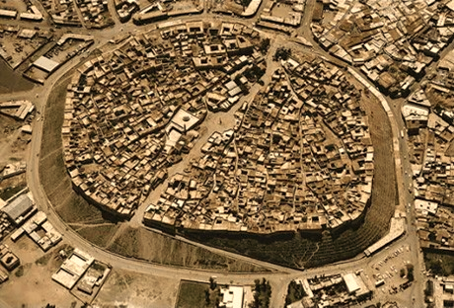
Erbil Citadel
Elliptical shape with long diameter of about 430m and short diameter 340m, 102,000 square meters
10.2 hectares in area, it rises 32 meters above the rest of Erbil city
The Citadel consists of traditional
courtyard houses and narrow alleyways surrounded
by contiguous houses that generate its fortified look
perimeter wall

Slide 4
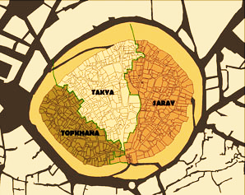

Slide 5
Erbil Citadel Revitalization Project
“In 2006 ,the KRG decided to depopulate the Citadel so that it could be conserved and revitalized.”(HECER)
" P
“In 2008 , Erbil Citadel Revitalization Project was started by the
High Commission for Erbil Citadel Revitalization(HCECR) in collaboration with (UNESCO) to introduce the (Conservation and Rehabilitation Master Plan) which provides a comprehensive program for bringing the Citadel back to life as a center of culture, recreation and tourism in the heart of the modern city of Erbil.”(HECER)

Slide 6
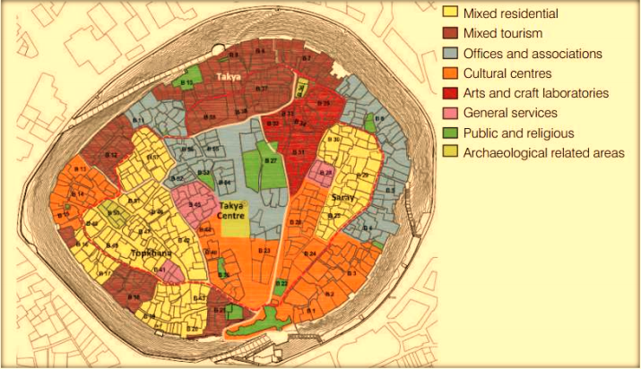
“In order to preserve and enhance this unique historic town,
a ‘Conservation and Rehabilitation Master Plan’ has been proposed to serve as a major decision making tool for
the High Commission for Erbil Citadel Revitalization” (HCECR).

Slide 7
Erbil Citadel Revitalization Project
Within the whole process of revitalization Erbil Citadel has witnessed different works and procedures. Those procedures can be classified into two main groups; physical preservation procedures and adaptive re-use procedures.
Physical Preservation Procedures:
These procedures are related with the goal of preserving, improving and promoting the architectural, physical and structural quality of the Citadel buildings and structures along with promoting environmental and hygienic conditions.
Adaptive Re-Use Procedures:
The second includes the procedures that are related to the concept of adaptive reuse as the adopted strategy for dealing with the preserved buildings

Slide 8
Adaptive Reuse of Erbil Citadel: why ?
As Erbil Citadel has an outstanding heritage value,
Adaptive Reuse is the tool to support the understanding of that heritage while accommodating new functions.
Adaptive Reuse gives new life to the Citadel, rather than freezing it at a particular moment in time as it explores the options between the extremes of demolition or turning the Citadel into a museum
Accordingly, a range of viable functions have been proposed mixing four main use categories for the three Citadel historical districts of the; Saray, Takaya and Topkhana. These categories are: cultural-related uses, touristic-related uses, residential-related uses in addition to areas for archeological excavation

Slide 10
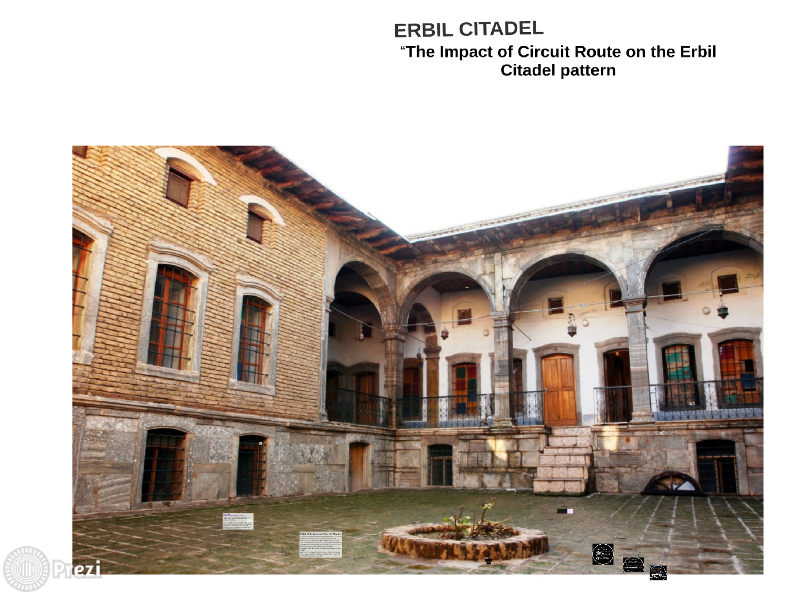

Slide 11
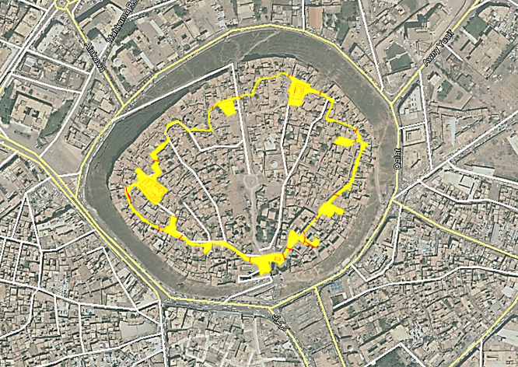
Circuit Route As Part Of The Revitalization Project
Recently, an urban element called
(The Circuit Route)
has been proposed by UNESCO
in cooperation with
High commission of Erbil Citadel Revitalization .
It includes developing a tourist circuit path and other subsidiary trails at Erbil Citadel, along with rest areas with needed facilities

Slide 12
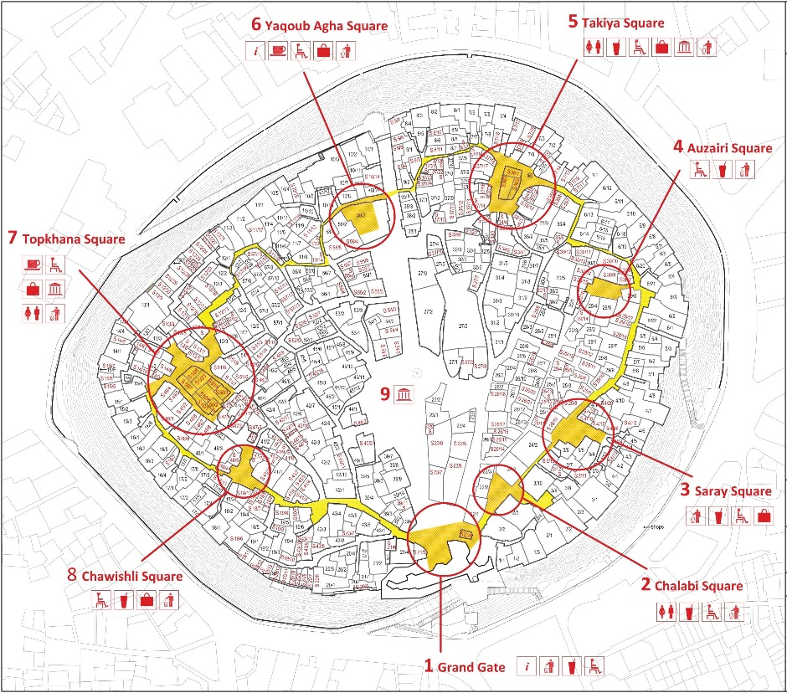
It was intended to promote new paths in the Citadel branching out other secondary paths to offer a greater opportunity for the visitor to visit the larger part of the citadel.
The aim of the circulation paths and trails is to facilitate the movement of visitors and guide them towards specific areas of the site, at the same time information and facilities will be provided at specific locations.

Slide 13
Circuit Route As Part Of The Revitalization Project
These would help in the valorization of the site and in providing rest areas that would enhance the visitors' experience.
Moreover, paths will help to bring back to the visitor the sense of the place and the historical urban fabric
(HCECR and UNESCO office in Iraq).

Slide 14
Circuit Route As Part Of The Revitalization Project
A series of eight rest areas are proposed along the circuit, starting from the southern Grand Gate (rest area no.1) and moving counterclockwise.
Each rest area could have its own name and accordingly its own theme, to be determined by a specific marketing study, i.e. the name of a prominent house in the area.

Slide 15

Increasing the time that visitor spend in visiting the citadel to know about the heritage and tourism area Erbil Citadel.
The rest points gives space for visitors to enjoy and see the atmosphere of the Citadel
Stop and break points gives visitors opportunities to enjoy and in the historical atmosphere of urban pattern and architectural of Erbil Citadel.
All rest areas would include a minimum of facilities (i.e. shady seats and waste bins), while some of them would offer more services. Thus rest areas would function as focal points of the tourist circuit and of the organization of tourism-related business.

Slide 16
The Circuit Route includes certain morphological transformations in
The urban space of the Citadel and consequently upon the pattern
Of that urban space
1.Grand gate,
2. Chalabi square,
3. Saray square,
4. Auzairi square,
5. Takiya square,
6. Yaqooub Agha square,
7. Topkhana square,
8. Chawishli square

Slide 17
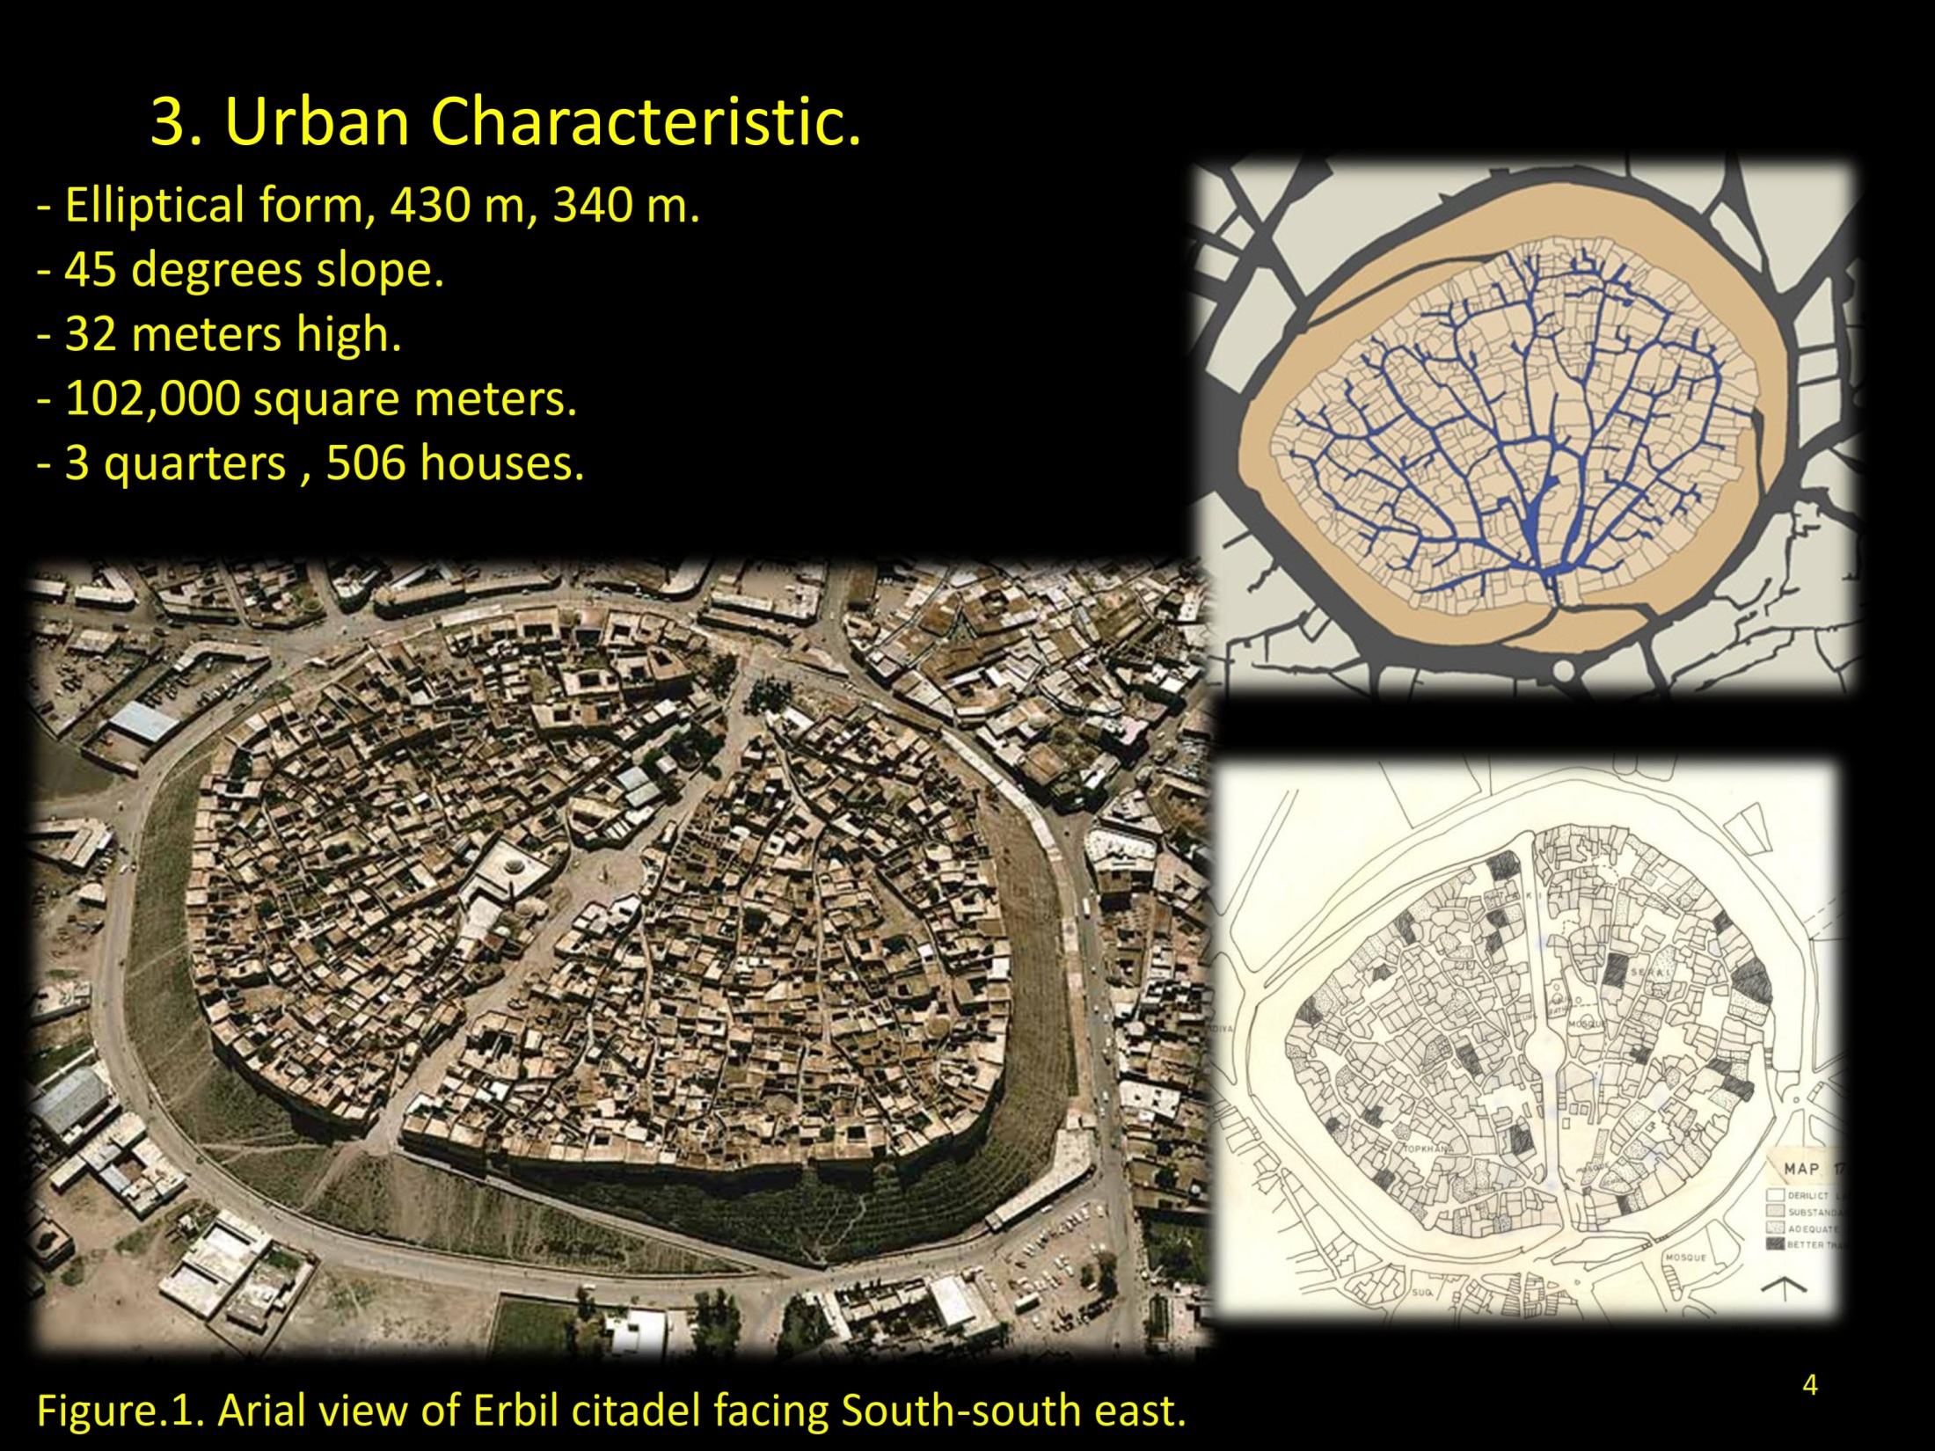
Breakthrough Street As Inserted In Erbil Citadel
The main impact of the Circuit Route on Erbil Citadel is the transformation of urban space pattern
Nevertheless, this is not the first geometrical transformation in the urban space pattern of Erbil Citadel
The Erbil Citadel has witnessed a major transformation in the geometry of its urban space pattern at the End of the fifth decade of the 20th century.
A breakthrough straight street has been inserted and imposed on the organic pattern of the Citadel

Slide 18
Breakthrough Street As Inserted In Erbil Citadel
The main objective of this action was to provide the urban infrastructures such as streets for the vehicles appeared recently, water supply, drainage system and so on, an objective not realized actually.
The central breakthrough straight street ,which penetrate the urban fabric of Erbil Citadel from the south to the north where a new gate was created, had a drastic geometric impact upon urban space pattern of the Citadel, because the inserted straight street has different geometric logic from the already existed pattern.

Slide 19
In order to
define the impact of the Circuit Route on urban space pattern
A comparative study is to be carried on between
The urban space of Erbil Citadel in its original status
And the urban space after the Breakthrough Street was added in 1950s
And the urban space after the proposed Circuit Route to be added later

Slide 20
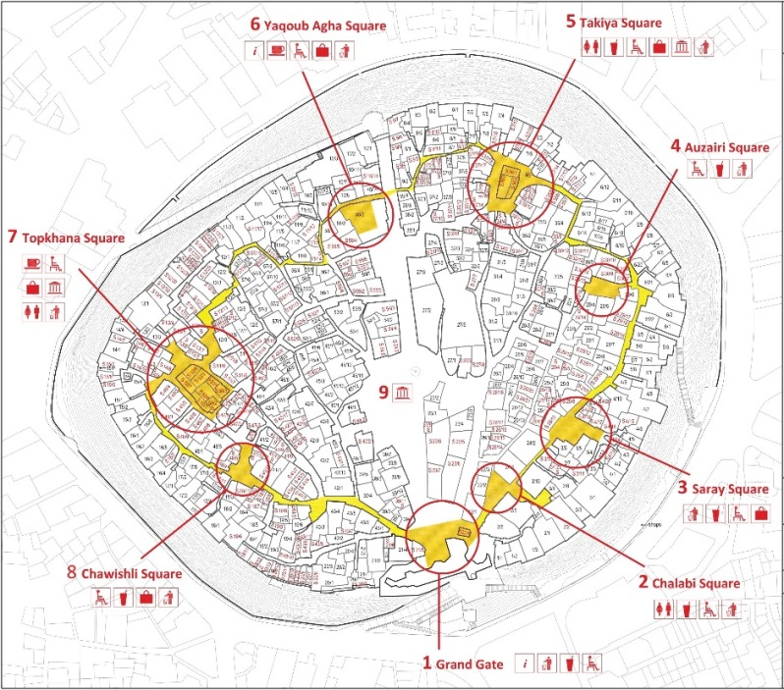
Erbil Citadel
1950s
Erbil Citadel
2010s
Erbil Citadel
1920s

Slide 21
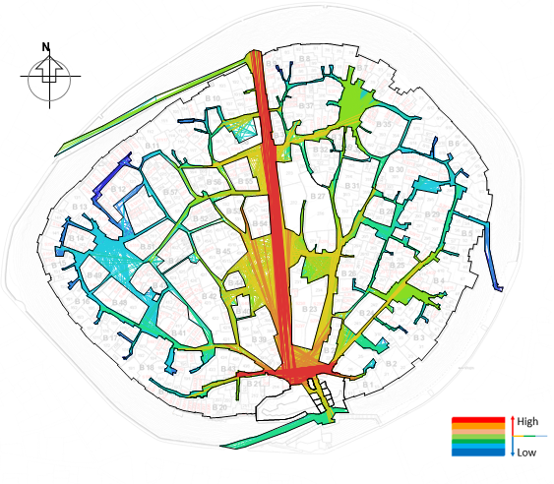
Erbil Citadel
1950s
Axial Analysis
Erbil Citadel
2010s
Axial Analysis

Slide 22
Analysis Results & Conclusions
The geometric analysis of Erbil Citadel original urban space shows that:
The Citadel is covered mostly by short center lines (representing the Citadel Allyways) covering it on the global scale. This patterns presents a geometric characteristic by which the Islamic City is distinguished.
The Citadel is covered mostly by narrow allyways, a geometric characteristic by which the Islamic City is distinguished.
There are a very large number of intersections in which the center lines do not continue uninterrupted after the point of intersection. This phenomenon appears in Erbil Citadel on the global level. This presents a geometric characteristic by which the Islamic City is distinguished.

Slide 23
Analysis Results & Conclusions
2. The geometric analysis of Erbil Citadel urban space after the addition of the breakthrough street shows that:
In terms of the length of circulation axes, The automatic analysis by Depthmap Software has shown that the fewest number of the longest axial lines which cover Citadel urban space is 149 lines. These lines are varied in their length from the longest line (321m) represents the longest portion of the axis that penetrate the urban space between the two gates whereas the shortest axial line is about (7.3m). These results shows a clear dispersion and asymmetry in the pattern of lines length which are reflected in the high values of the standard deviation (42.625) and the skewness (2.783). Therefore, two distinct patterns of axial lines in terms of their length are picked up.
As for the width of circulation axes, two distinct patterns of width are picked up, as the breakthrough street is wide in comparison with most axes which are narrow.

Slide 24
Analysis Results & Conclusions
Two distinct patterns of center lines intersections are picked up. There are a large number of intersections in which the axial lines do not continue uninterrupted after the point of intersection. This phenomenon appears in Erbil Citadel on the global level and it also presents a geometric characteristic by which the Islamic City is distinguished. Also, there are fewer intersections of axial lines which continue uninterrupted. This type of intersections appears clearly in the parts of the Citadel which surround the central axis.
These two distinct patterns of center lines lengths, width of axes and of intersection types imply that there are two geometric logics in Erbil Citadel. It is believed that these patterns are the consequences of the straight street that penetrated the traditional organic urban fabric of Erbil Citadel in the middle of the 20th century.

Slide 25
Analysis Results & Conclusions
2. The geometric analysis of Erbil Citadel urban space with the proposed Circuit Route shows that:
In terms of the length of center lines of its axies, the Circuit Route is consisted of short center lines . This pattern sustains the geometric characteristic of corresponding urban space.
As for the width of circulation axes, the axes of the Circuit Route sustain the narrow width of the original axes to which the correspond.

Slide 26
Analysis Results & Conclusions
As for the intersections of the center lines of the Circuit Route segments, there is also a large number of intersections in which the center lines do not continue uninterrupted after the point of intersection. These intersections sustain to a large extent, the same characteristics of the corresponding intersections.
These distinct patterns of center lines lengths, width of axes and of intersection types imply that the Circuit Route sustain the geometric logic dominating the urban space of Erbil Citadel. Therefore, it is believed the Circuit Route is expected to has positive impact on the urban space pattern of Erbil Citadel.

Slide 27
Thank You

