Slide 1
Urban Form & Structure of Residential Area in Duhok
Characteristics and Typologies
Dr. Layla M. Raswol
College of Engineering
April 16 2017

Slide 2
Contents
Introduction
Development of Residential Area in Duhok
Case Studies
Methodology
Results
Conclusion

Slide 3
The Concept of Urban form and structure
Residential Urban Form and Structure is the spatial relations
between housing units and their services and activities, which
resulting physical characteristic of the area.
Lynch (1981) indicators influencing the value of residential area:
Density, access system, settlements composition
Street design, block size, plot size, greenery , pattern o f open
Spaces

Slide 4
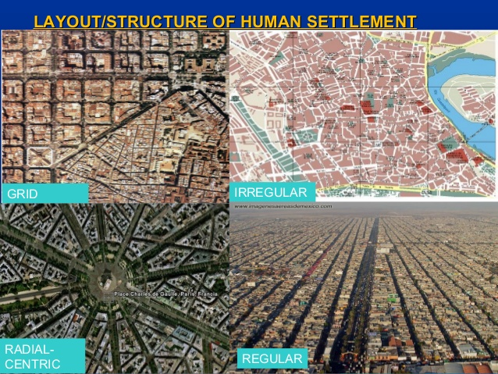

Slide 5
Research Objectives
to determine the main planning and design concepts of the current housing structure in Duhok
to provide conceptual framework and guidelines for future housing development.

Slide 6
Study Area, Duhok City
60% of the built up area is residential (15 m * 3km
The population density in Dohuk ranges from less than 50 to more than 250 inhabitants per hectare and differs in various residential area.

Slide 7
Types Residential Area
1. The inner city residential area including the old city center and the surrounding neighborhood with their main commercial streets and compact housing and street grids.
2. The new Eastern and western Part residential area including the new developed suburban area
3. The legalized informal settlement, which suffered from problems such as lack of facilities and services, improper land use, shortage of open and public spaces

Slide 8
measurements indicators
Land use
Intensity (development grade)
Street System
Blocks arrangement
Plot system
Building system

Slide 9
Case Studies
case studies were chosen to represent inner, Eastern and western neighborhoods within the city and to present a wider range of neighborhoods:
Masike (West Part)
Nezarke (East Part)
Barosheke (informal East)
Ronahi (Southern)
Data Collection methods: Observation, Maps and documents analysis

Slide 10
Results

Slide 11
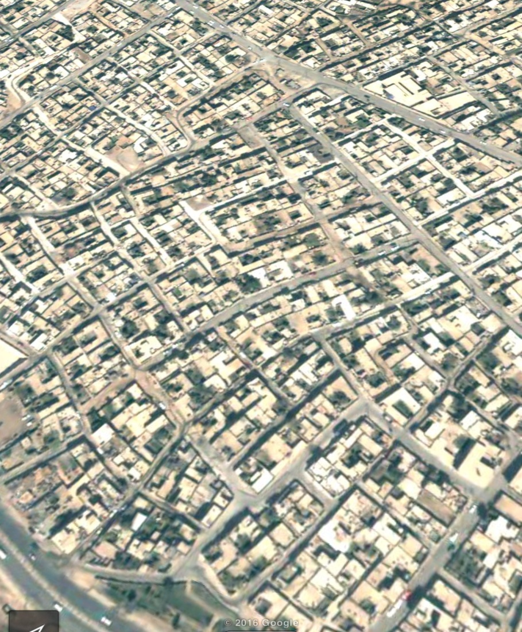
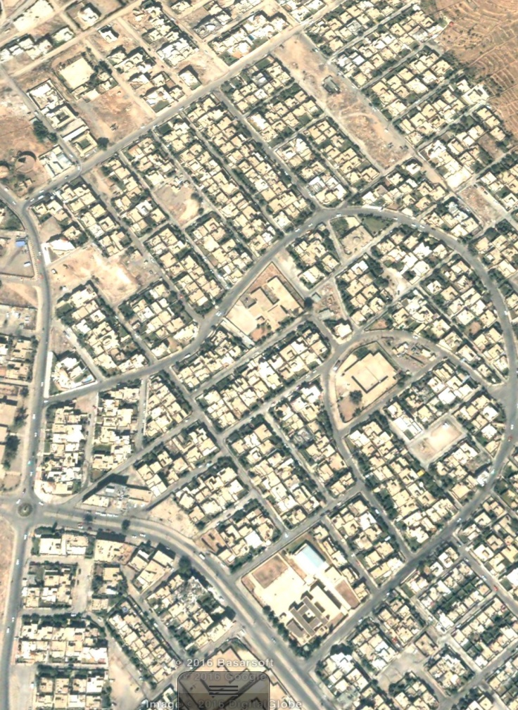
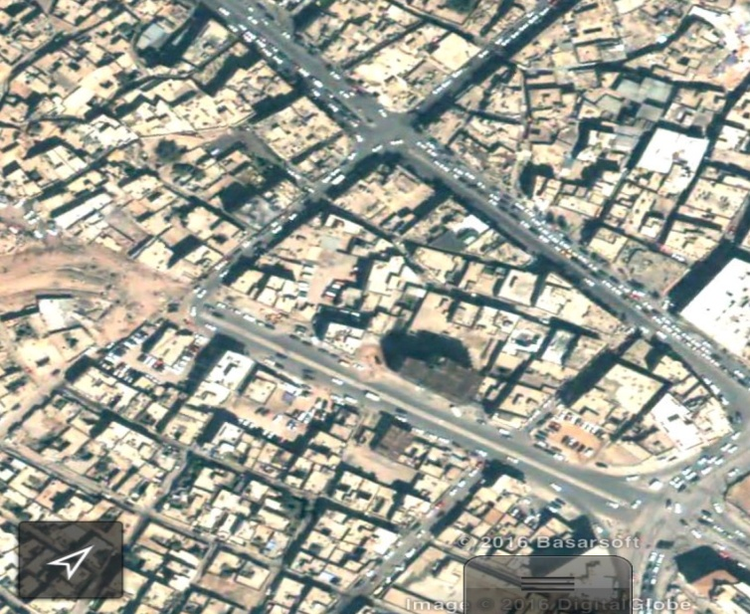
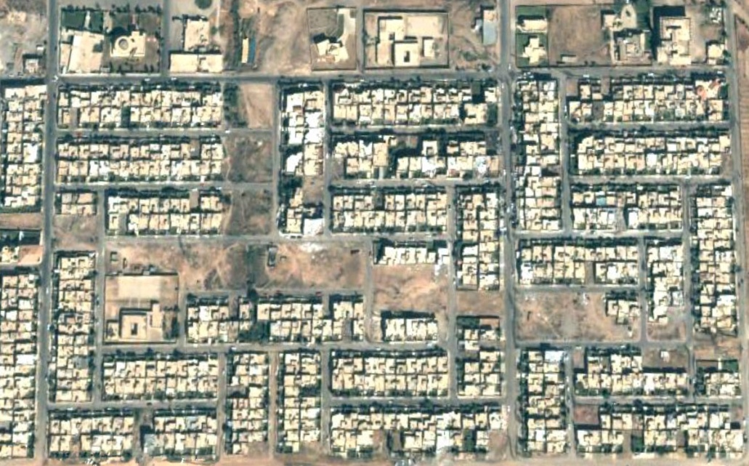
Characteristics of Neighbourhoods
Intensity

Slide 12
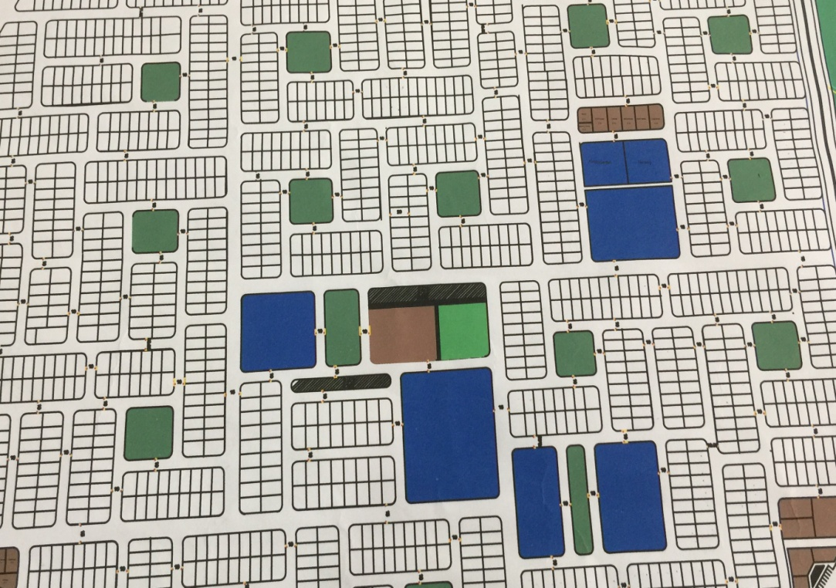
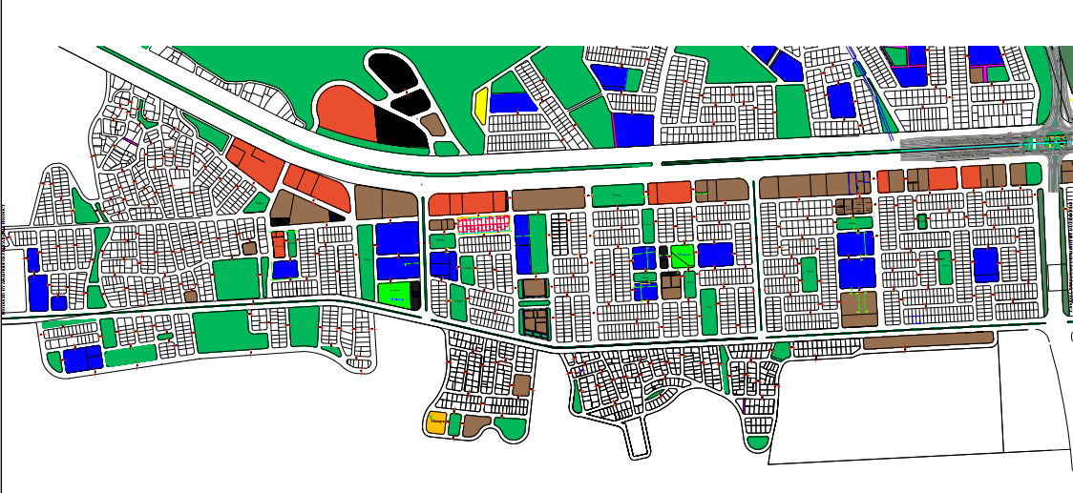
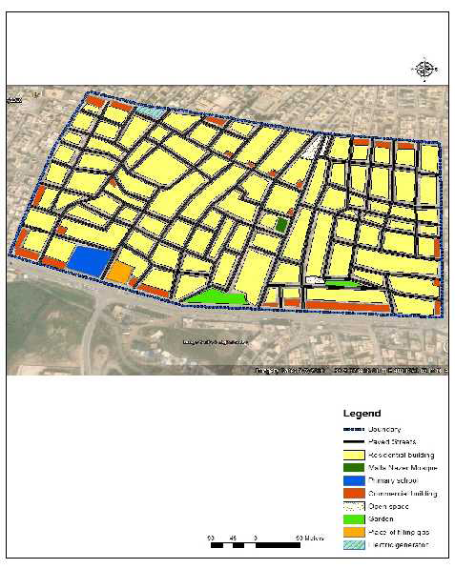
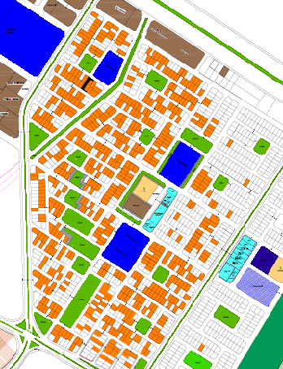
Characteristics of Neighbourhoods
Land use

Slide 13
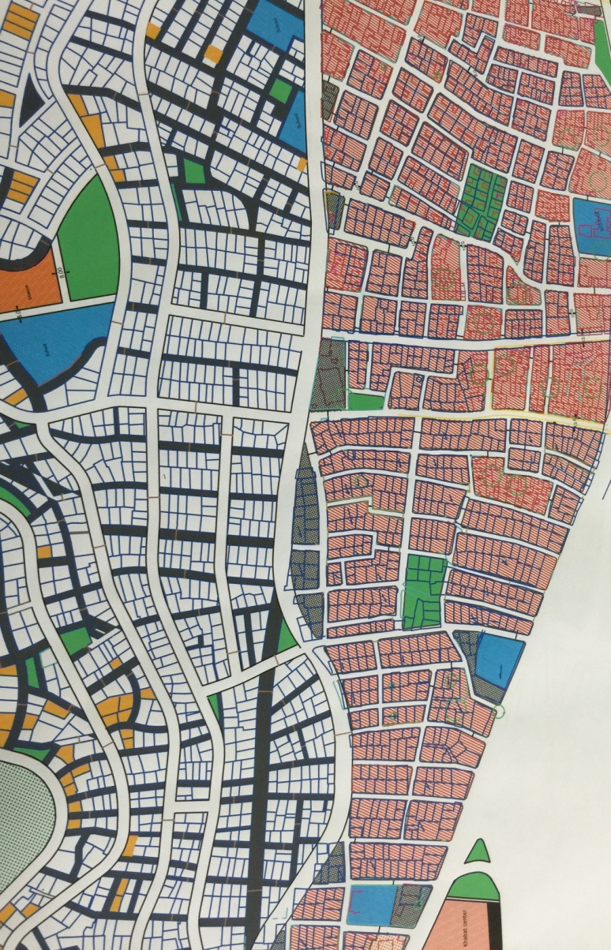
Characteristics of Neighbourhoods
Street System

Slide 14
Characteristics of Neighbourhoods
Block and plot System

Slide 15
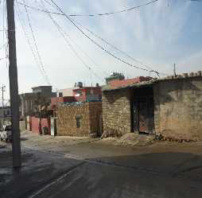
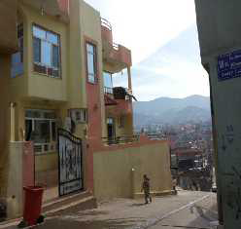
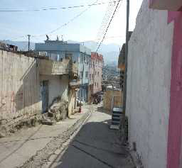
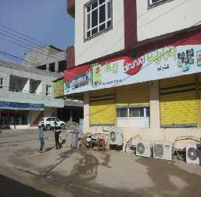
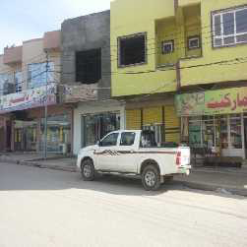
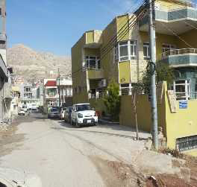
Characteristics of Neighbourhoods
The Buildings System

Slide 16
Conclusion
the residential areas in Duhok city vary in term of neighborhood components; Streets. Land use, Building as following:
Street Design:
- The quarters are surrounded by main street mostly 20 m width, access street 10m width developed according to available finance source.
The streets are wide to connect different sectors of the city through cars s instead of walking
lack of street hierarchy, safe pedestrian and greenery.
The side walks are not well designed
Land use diversity:
the existing mix land use activities depends on the range of development. More compact in the early developed area.
-Lack of services and green area in the early developed area

Slide 17
Conclusion
Block and Building Design
Diverse block configurations, building types and architectural contribute to identify neighborhood which is not considered to distinguish the character of the them:
The spatial geometry of the old tradition urban fabric seems to have developed from lack of planning, (individual development)
The new urban forms present grid patterns and building regulation
The housing pattern and building styles are mainly influenced by economic consideration and formal building regulation.
The new planning and design style do not consider the social, cultural and environmental dimension of the tradition of court houses

Slide 18
Recomendation
Create policies and implementation tools that defined the neighborhood characteristic and urban forms.
Delivering sustainable housing in term of integrating of school, community centers transports and amenities
Enhance the livability of the neighborhood (by upgrading the quality of development and improving the quality of public realm.
Establishing street hierarchy and improving the sidewalks and pedestrian
Formulating building and design standards to raise the quality of design
Determine appropriate urban design elements at the neighborhood level such as sidewalk width and material, street lights and trees and attractive landscape architecture.

Slide 19
Thank You

